Slide 1
Camico Sales Data Insights
Presented By :
Spectral Tech Analytics Team

Slide 2
Accounts and Opportunities

Slide 3
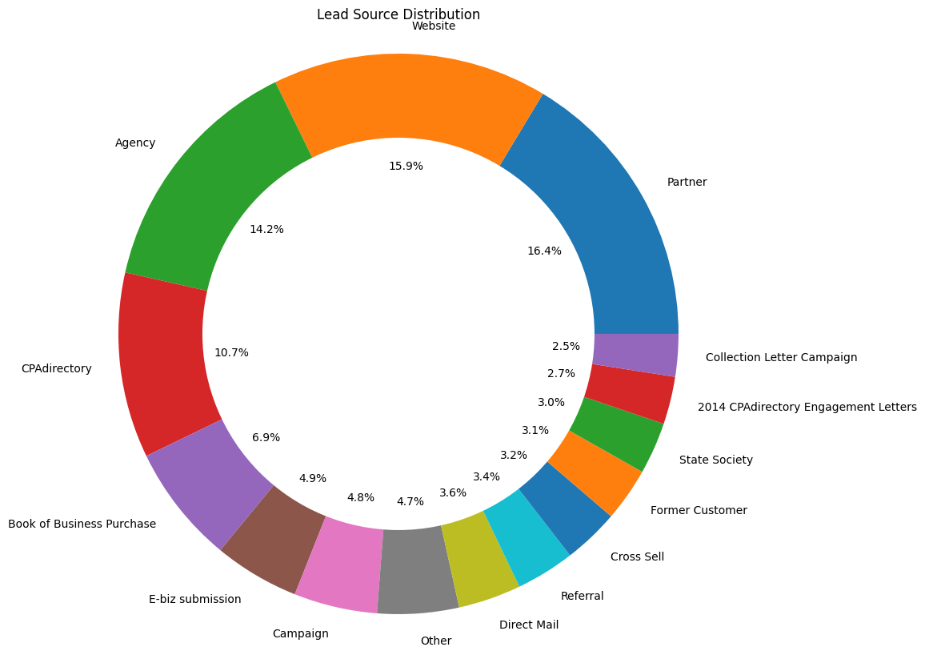
Lead Source Distribution
The graph shows that the company's top lead sources are its website, agency, and partner, CPAdirectory. These three sources account for over 55% of the company's lead sources. It's advisable for the company to focus on optimizing strategies for these key sources.
Looking at the circular graph helps the company adjust its plan for getting new customers. The focus should be on the important places where most customers come from, like the company's website. At the same time, it's smart to check out new places to find even more customers and make the business grow.

Slide 4
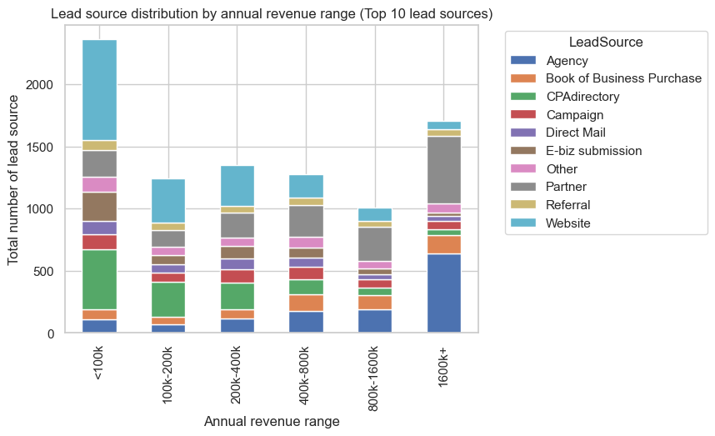
Lead Source v/s Annual Revenue
Agency and Partner are the key contributors to generating opportunities with high annual revenues. The company should continue to invest in its agency and partner relationships to maintain and improve its revenue performance.
Website and CPAdirectory are the primary contributors to generating opportunities with low annual revenues. The company should continue to optimize its website for search engines and conversions.
The company should track its revenue performance over time to see which lead sources are improving and which ones are declining.

Slide 5
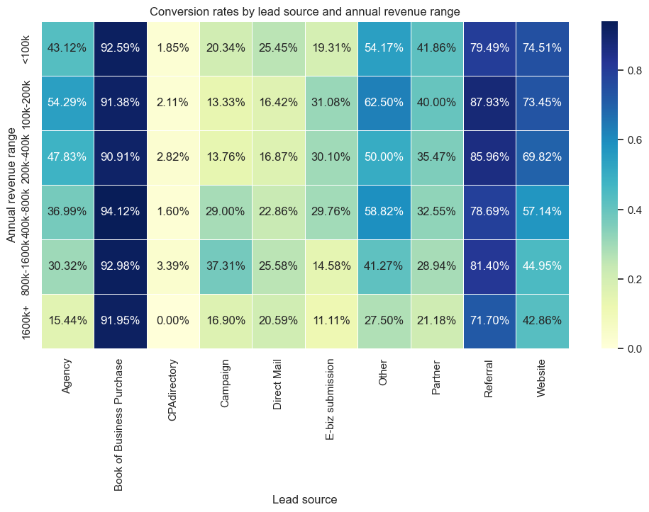
HeatMap: Lead Source(X) vs Annual Revenue(Y)
Top Performers: Book of Business Purchase and Referrals consistently excel with high conversion ratios across all revenue brackets.
Underperformer: CPAdirectory lags significantly with almost negligible conversion rates across brackets, warranting a reevaluation.
Revenue Dynamics: Other lead sources generally exhibit lower conversion rates for higher annual revenue, emphasizing the need for targeted strategies.
Agency Variation: Agencies, while substantial lead generators, show a lower conversion ratio for higher annual revenue leads.
CPAdirectory Focus: While a major lead source, CPAdirectory registers the lowest conversion rate, signaling an area for improvement.
Website Dynamics: The website, a significant lead source, sees a lower conversion ratio for lower annual revenue leads.
Consistent Trend: Across all sources, there's a consistent pattern of decreasing conversion rates as annual revenue increases.

Slide 6
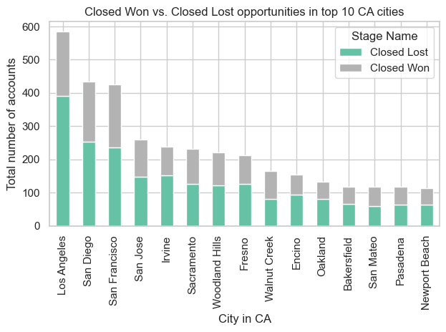
Conversion Comparison in CA Cities
Los Angeles leads in closed Lost opportunities, trailed by San Diego and San Francisco, showcasing business prospects. Conversely, Irvine records the highest closed lost opportunities, signaling lowest conversion, followed by Sacramento and Woodland Hills.

Slide 7
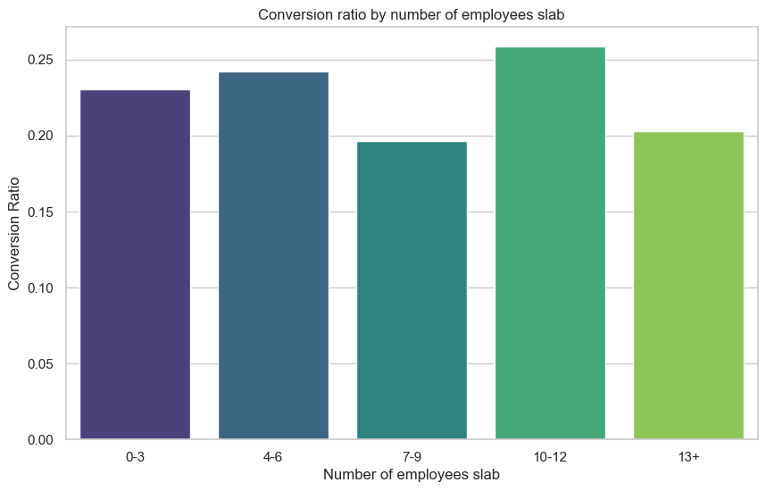
Conversion Ratio v/s Number of Employees
The graph you got indicates that as a company's employee count goes up, so does its conversion ratio, peaking at 25% for companies with 13 or more employees. This is likely because bigger companies have more resources for sales and marketing, plus experienced teams.
Here are some quick reasons why this might be happening:
Larger companies can afford fancy tools like CRM software to manage their sales pipeline.
They might have a dedicated sales team working hard to close deals.
A bigger company often means a stronger brand, making it easier to turn leads into customers.

Slide 8
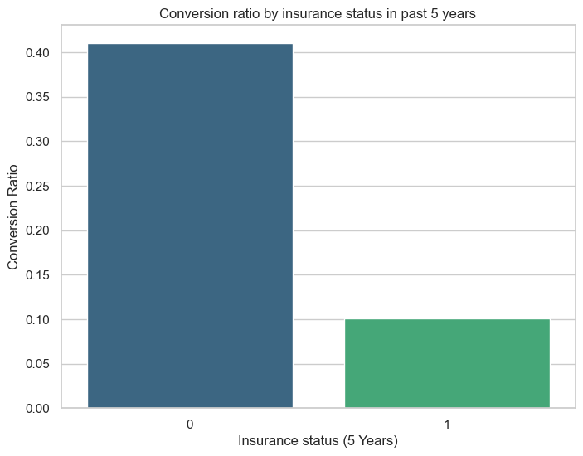
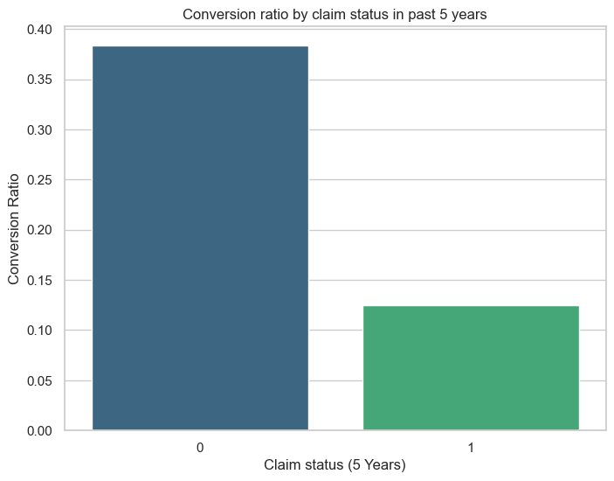
CR with insurance and claims in last 5 years
In last 5 years the conversion rates are higher for no insurance history which bags more than 40% of the conversion whereas only 10% conversion was achieved where insurance was claimed
Over the last 5 years, the data reveals a noteworthy trend: entities without any claims history boast a robust 35% conversion rate, indicating a higher likelihood of successfully turning leads into customers. On the flip side, entities with a claims history face a tougher challenge, achieving a modest 13% conversion rate. This substantial difference underscores the considerable impact that claims history has on the conversion process, with those without claims history enjoying a more favorable outcome in the conversion game.

Slide 9
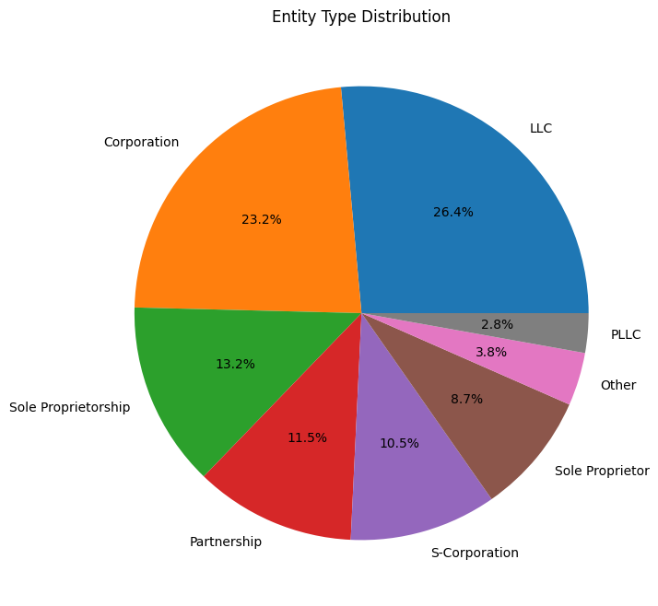
Entity Type Distribution
from the graph we can say that most opportunities are coming from four types of entities:
LLC (Limited Liability Company)
Corporation
Sole Proprietorship
Partnership
These are the big players in the opportunity game. Each type has its own way of doing things.

Slide 10
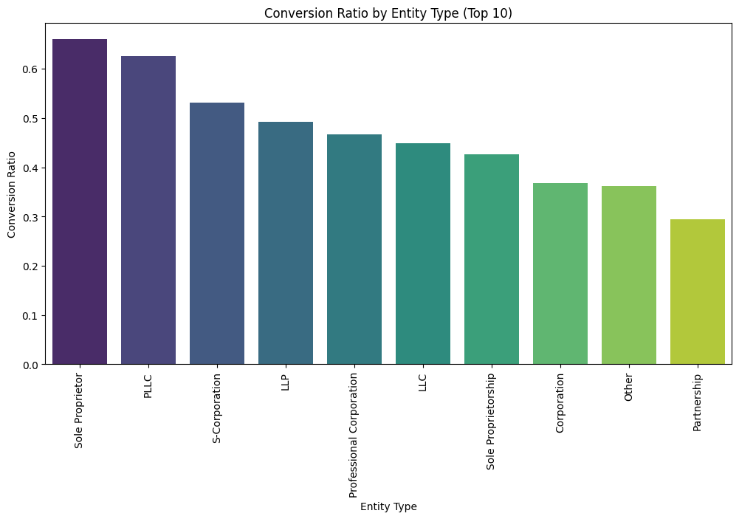
CR for different Entity types
The graph dives into the conversion ratio based on entity types for the top 10 entities. Conversion ratio is just the percentage of leads that turn into actual customers. Here's the breakdown:
Sole Proprietorship contributes to major conversion with more than 60% conversion ratio. that is Half of the leads from sole proprietorships become customers.
PLLC is next in line, hitting a solid conversion ratio (more than 50 %).
On the flip side, Partnership has the lowest conversion ratio at 35%. for every 100 leads, only 35 of them from partnerships turn into customers.

Slide 11
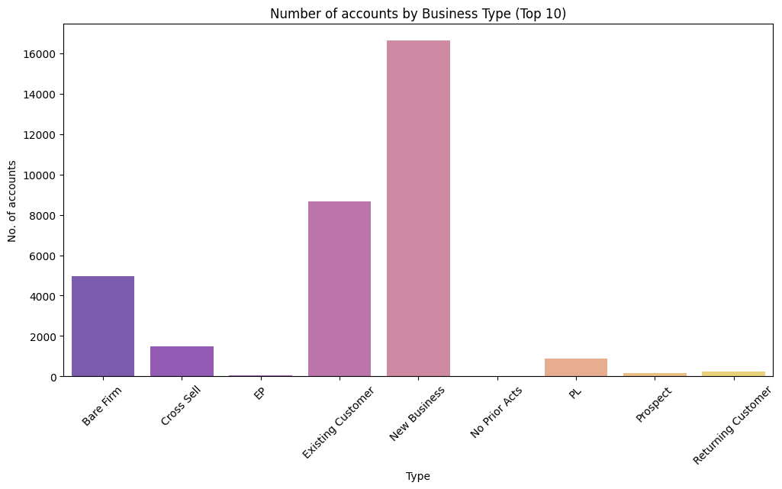
Number of accounts for different Business types
The top 3 business types with the most accounts are existing customers, new businesses, and Bare firm. new businesses have the most accounts, with more than 16,000 accounts. Existing customers have over 9,000 accounts, and Bare firm have over 5000 accounts.
The other business types with a significant number of accounts are cross sellers, returning customers, and PL. PL have over 1000 accounts, cross sellers have over 1500 accounts, returning customers and prospects has least account.
Overall, the graph shows that the majority of customer accounts in the United States are for existing customers, new businesses, and Bare firm. The other business types also have a significant number of accounts, but not as many as the top 3.

Slide 12
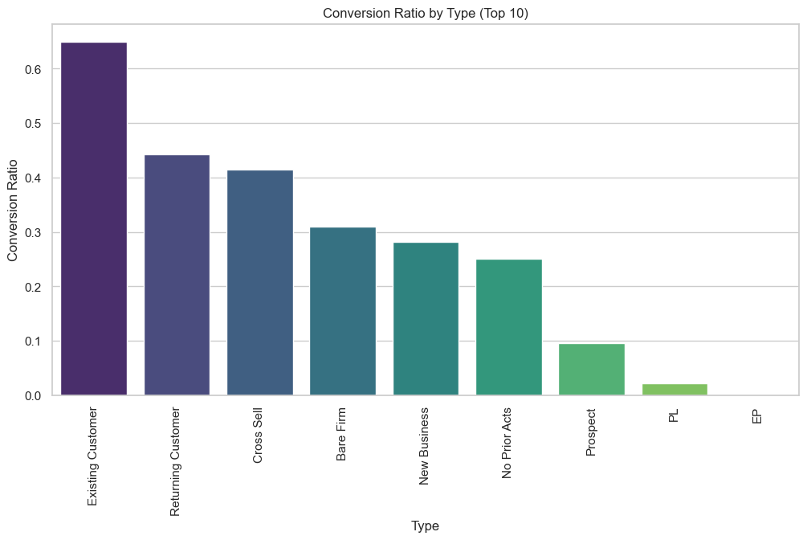
Conversion ratio for different business types
Despite being the major contributors, these entities showcase a lower conversion rate, hovering around 0.3. This means that approximately 30% of leads from Bare Firms and New Businesses successfully convert into customers.
So, while they play a significant role in the numbers game, the conversion rate suggests there might be room for improvement in turning these leads into solid customers.
Also we see that there is a high chance for giving a boost to the conversion in case if a customer returns, along side cross sell.

Slide 13
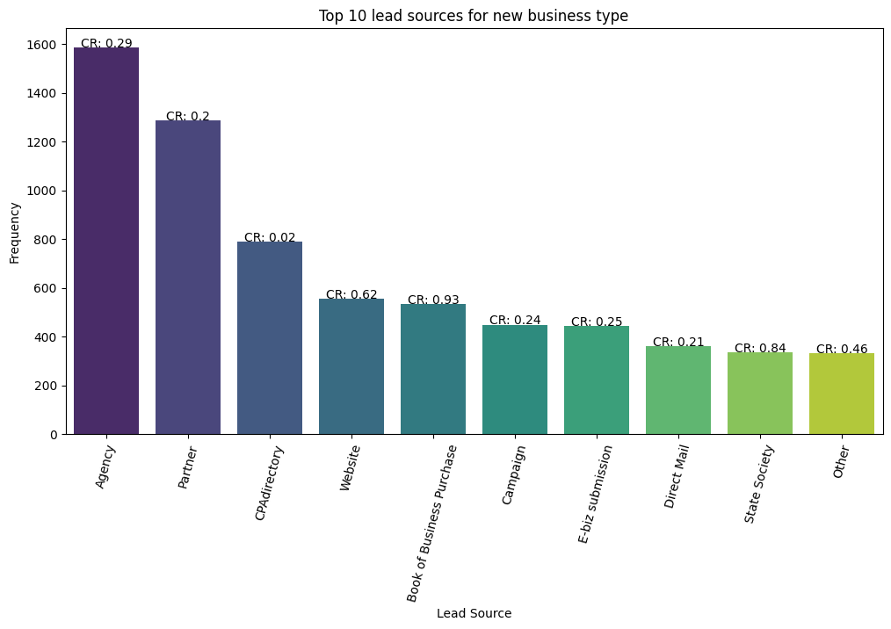
Conversion ratio for New Businesses
Lowest Conversion Ratio: Agency, Partner, and CPAdirectory exhibit the lowest conversion ratios. These entities face challenges in converting leads into customers efficiently.
Highest Conversion Ratio: Magazines, Websites, and State Society, on the other hand, boast the highest conversion ratios. These entities excel in converting leads into customers, showcasing a more effective conversion process.

Slide 14
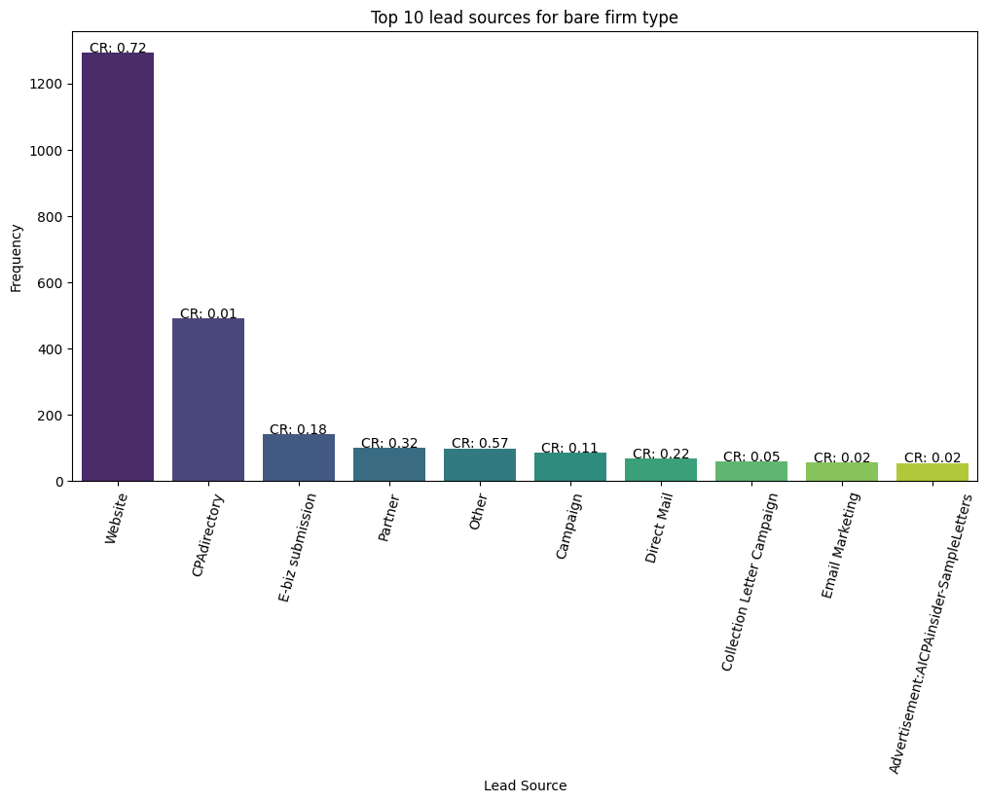
Conversion ratio for Bare Firms
CPAdirectory: Despite having the lowest conversion ratio, CPAdirectory holds the secondhighest contribution. This suggests a substantial presence in the data, albeit with a lower efficiency in leadtocustomer conversion.
Website: With the highest conversion ratio and the highest contribution, Websites stand out as a noteworthy performer in both effectiveness and overall impact on successful conversions.

Slide 15
Leads

Slide 16
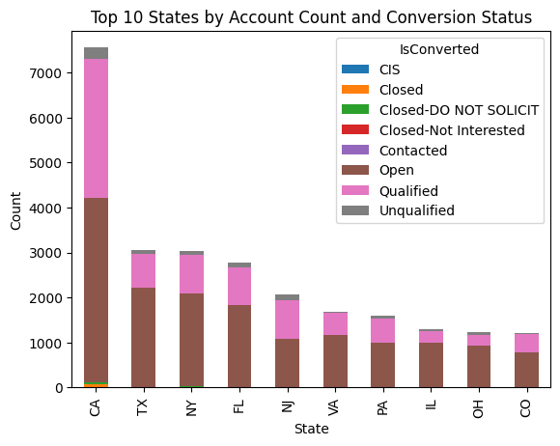
Conversion ratio for top 10 popular states
:
CA, TX, NY has highest number of leads and so highest number of opportunities

Slide 17
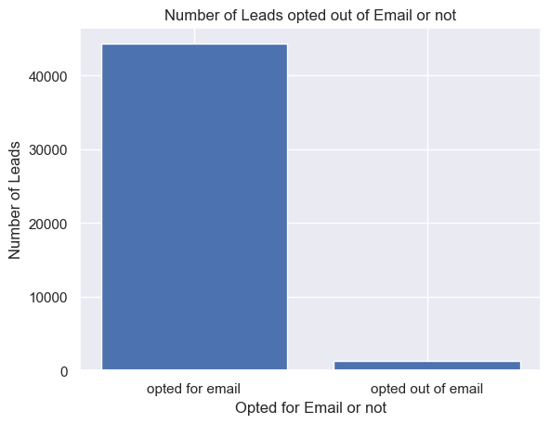
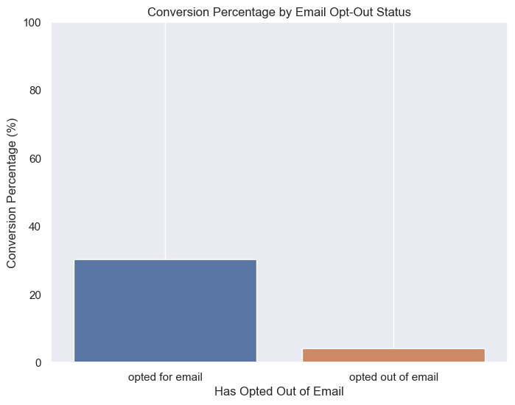
CR when opted for Emails
:
Most of the leads have opted for Emails and have higher conversion percentage comparatively.

Slide 18
Conversion rate and median conversion time v/s Titles
:
Owner, Mr., President, Partner and CPA are contacted the highest number of times
CEO, Managing manager, Sole Proprietor have higher conversion percentage
Higher the time taken lower the conversion chances
Average time taken=174 days

Slide 19
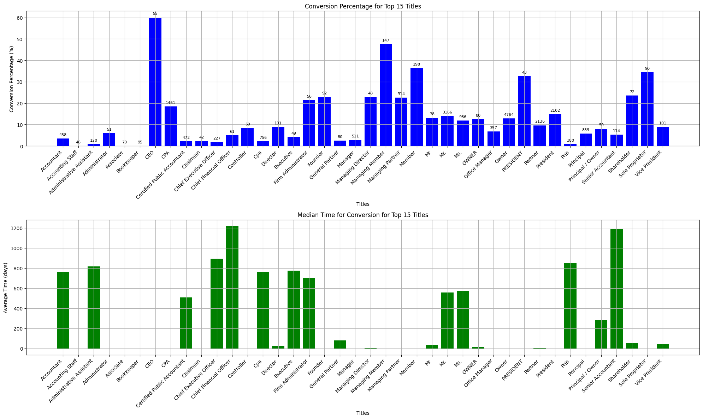

Slide 20
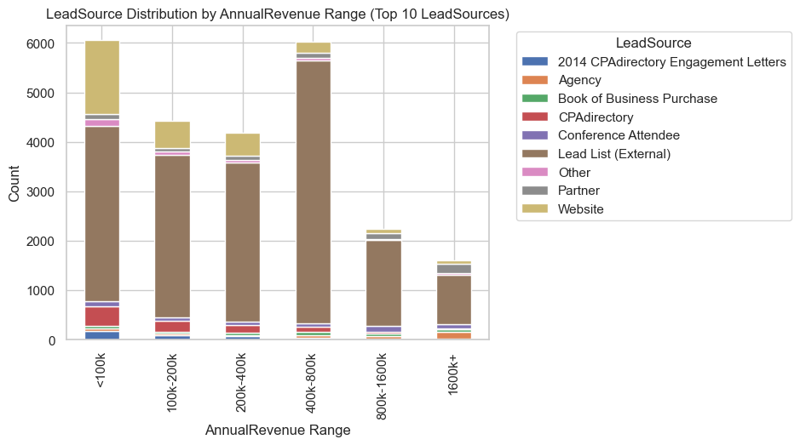
Lead Source v/s Annual Revenue
:
Lead list(External) is the key contributors to generating leads across all revenues
Website and CPAdirectory are the primary contributors to generating leads with low annual revenues.

Slide 21
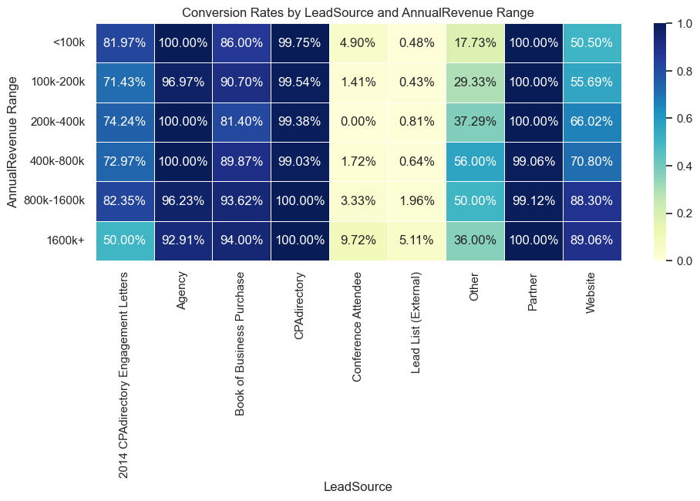
HeatMap: Lead Source(X) vs Annual Revenue(Y) for top 10 lead sources
:
Agency, Magazines, CPAdirectory and Partners consistently exhibit a high conversion ratio across all revenue brackets.
In contrast, Lead List and Conference Attendee shows an almost negligible conversion ratio across all brackets.
Website displays a lower conversion ratio for leads with lower annual revenue, compared to the higher annual revenue.

Slide 22
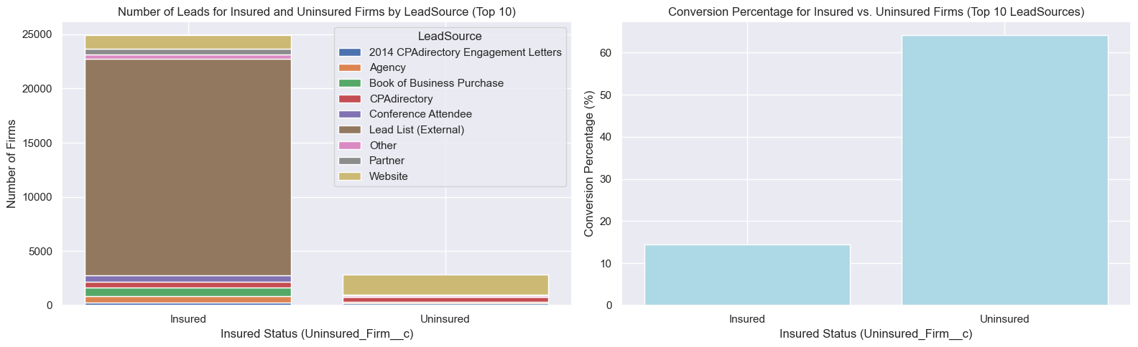
CR v/s firm is insured or not
:
Uninsured firm leads have higher conversion percentage compared to Insured firms. Most of the leads are Insured firms
Lead list (external) is the most popular lead source for insured firms and have lowest conversion rate(~0%).
Websites is the most popular lead source for uninsured firms and has a good conversion rate

Slide 23
Analyzing sales variance across states

Slide 24
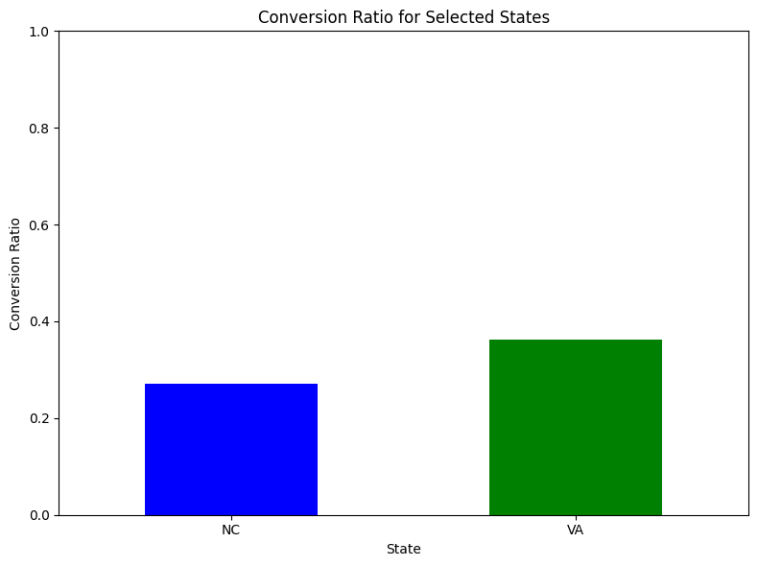
Conversion ratio comparison between Virginia and North Carolina
North Carolina (NC): Registers the lowest conversion ratio at 30%, indicating a comparatively lower success rate in turning leads into customers.
Virginia (VA): Exhibits a more favorable scenario with a higher conversion ratio, surpassing 40%. This implies a more efficient conversion process compared to North Carolina.

Slide 25
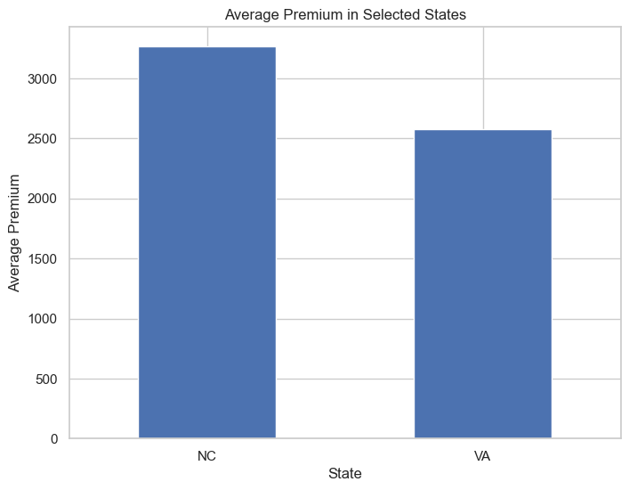
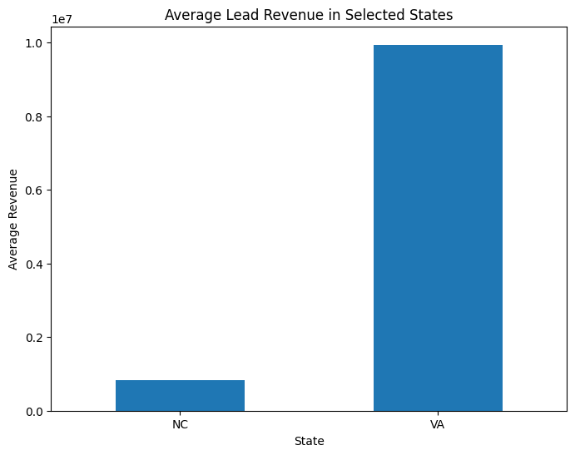
Average premium and average revenue comparison
North Carolina (NC): Demonstrates a higher average premium compared to Virginia, suggesting a relatively elevated pricing structure in the insurance market for this region.
:
Virginia: Commands a higher average revenue compared to North Carolina, indicating a potentially stronger economic performance in this region.

Slide 26
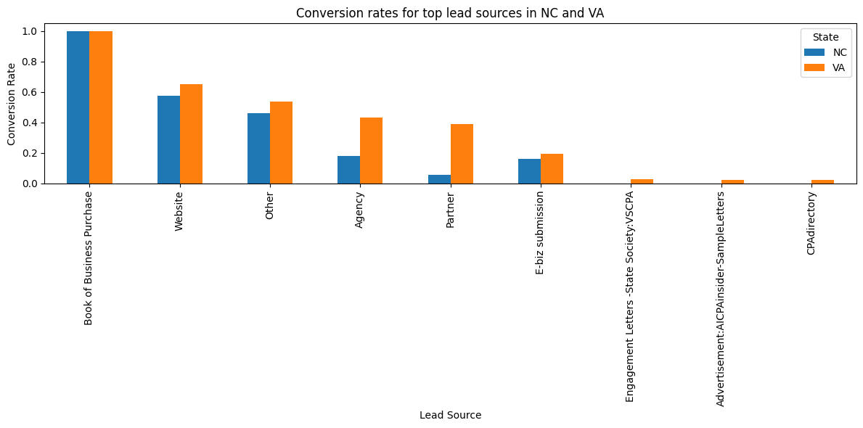
Conversion rates comparison of lead source
We've observed a distinctive trend in conversion rates among 'The Agency,' 'Partner,' and 'Website' categories. Specifically, these components exhibit higher conversion rates in the state of Virginia. However, it's noteworthy that this observed increase in conversion rates is not mirrored in North Carolina. Further analysis may be warranted to understand the regional variations impacting these specific elements.

Slide 27
Thank You

Slide 28
CAMICO DATASET
(28092023)
Presented By :
Spectral Tech Analytics Team

Slide 29
Content
Camico Dataset insights
Model training Leads
Model training opportunities
Model training Lamb Worker Compensation dataset

Slide 30
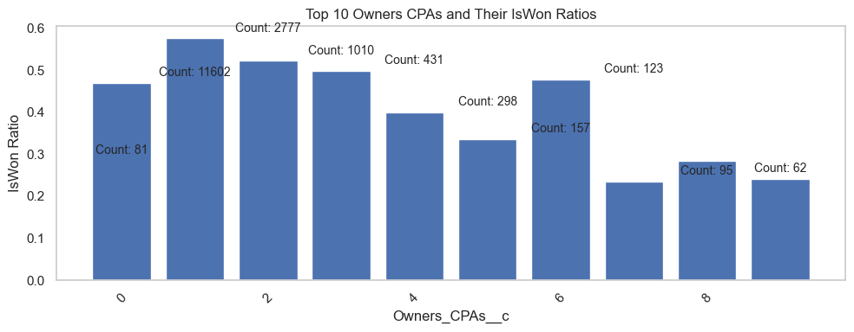
Opportunities Owner’s CPAs
Owner’s CPAs Impact on Conversion Percentage: There is an observed inverse relationship, where an increase in the number of Owner’s CPAs correlates with a decrease in the conversion percentage.
Missing Values: A substantial 20,000 missing values are identified within a dataset comprising 36,000 opportunities, highlighting a significant data completeness challenge that warrants attention.

Slide 31
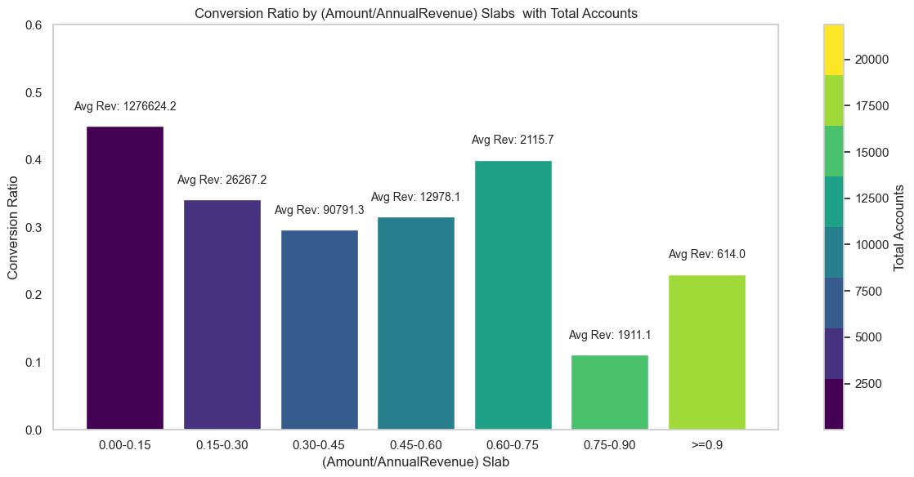
Amount v/s Conversion
1. Lack of Linearity between Amount and Annual Revenue:
The relationship between the Amount and Annual Revenue variables is not characterized by linearity, indicating a nonlinear dependence.
2. Higher (Account/Annual Revenue) Ratio for Low Annual Revenue Accounts:
Accounts with lower Annual Revenue exhibit a higher ratio of Account to Annual Revenue, suggesting a disproportionate impact of individual accounts on overall revenue for entities with lower financial standing.
3. Concentration of Accounts in Lower Annual Revenue Range:
The majority of accounts are concentrated within the lower range of Annual Revenue, signifying a prevalence of entities with relatively modest financial metrics.
4. Inversely Proportional Relationship between Conversion Ratio and (Amount/Annual Revenue) Ratio:
The Conversion Ratio demonstrates an inverse relationship with the (Amount/Annual Revenue) ratio, indicating that as the financial efficiency of an account decreases (as measured by the mentioned ratio), the likelihood of successful conversion increases.

Slide 32
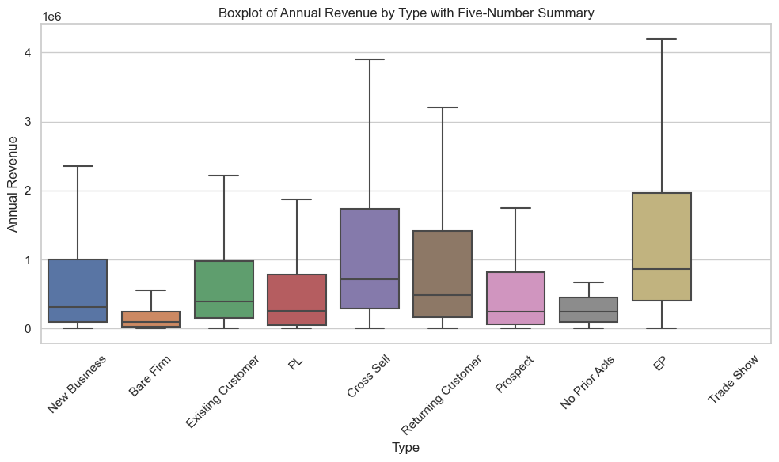
Business Type
Business types including Bare Firm, No Prior Acts, PL, and Prospect display the lowest median revenues.
Contrarily, EP stands out with the highest median revenues.
Noteworthy contributors to high median revenues include Cross Sell and Returning Customer categories.
Insight: This analysis provides a nuanced understanding of the varying financial performance among different business types.

Slide 33
Actionable insights
Lead Sources vs. Revenue:
High Revenue Opportunities: Consider elevating product or service premium offerings for leads originating from high-revenue sources, including Magazines, Agencies, and Partners.
Low Premium Opportunities: Tailor strategies for opportunities from sources like Websites and Ebiz submissions by providing discounts or adjusting pricing to enhance competitiveness.
CPA Directory Focus: Given the absence of conversions (0% conversion rate) across all slabs from CPA Directory, there is an opportunity to redirect focus towards other more productive lead sources.
Accounts/Business Types and Annual Revenue:
Lower Annual Revenue Opportunities (Bare Firm, No Prior Acts, New Business): Exploring potential improvements in conversion rates for lower Annual Revenue opportunities could involve strategically adjusting the Amount value downwards, aiming to enhance the likelihood of successful conversions.

Slide 34
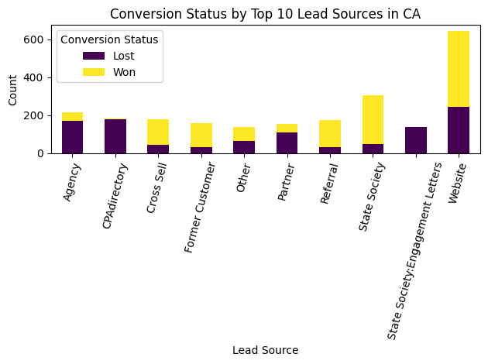
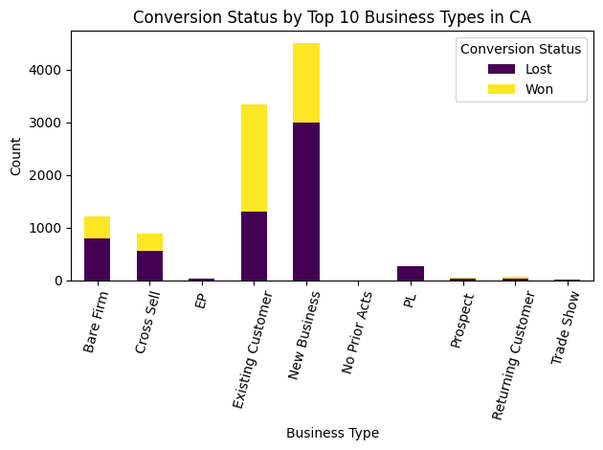
Analysis for state CA
Opportunities in State CA:
Lead Sources: Websites emerge as the primary contributors to opportunities in the state of CA, followed by State Society, Agency, CPAdirectory, and others.
Conversion Rates: Notably, Agency, CPAdirectory, Engagement Letters, and Partners exhibit comparatively lower conversion rates. Conversely, Websites, State Society, Referral, and Cross Sell demonstrate higher conversion rates.
Business Types and Opportunities: in which top contributors are New Business, Existing Customer, and Bare Firm stand out as the primary contributors to opportunity creation.

Slide 35
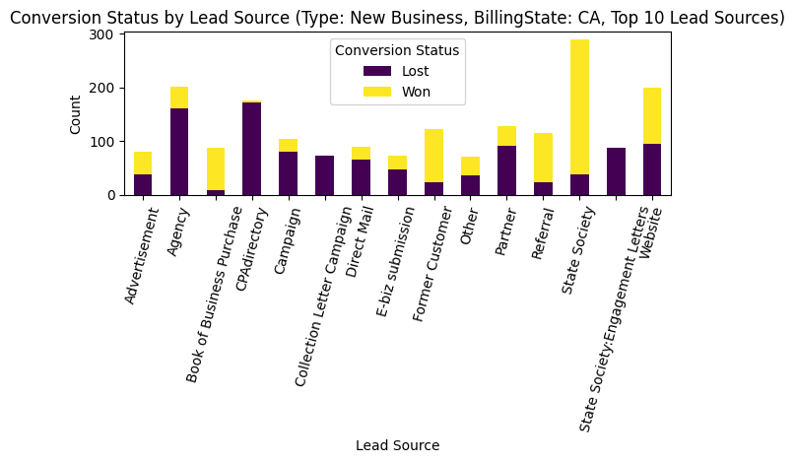
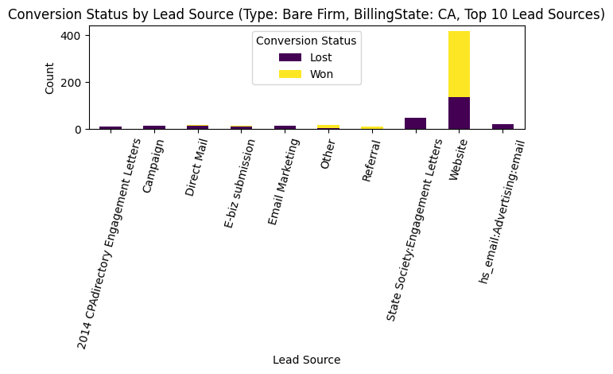
Analysis for state CA
New Business Opportunities:
Effective Sources: State Society and former customers demonstrate good conversion rates.
Less Effective Sources: CPAdirectory, Campaign, and Agency show suboptimal performance.
Bare Firm Opportunities:
Primary Source: Opportunities from websites have a strong presence.
Conversion Performance: Website-sourced opportunities exhibit commendable conversion rates for the Bare Firm type.

Slide 36
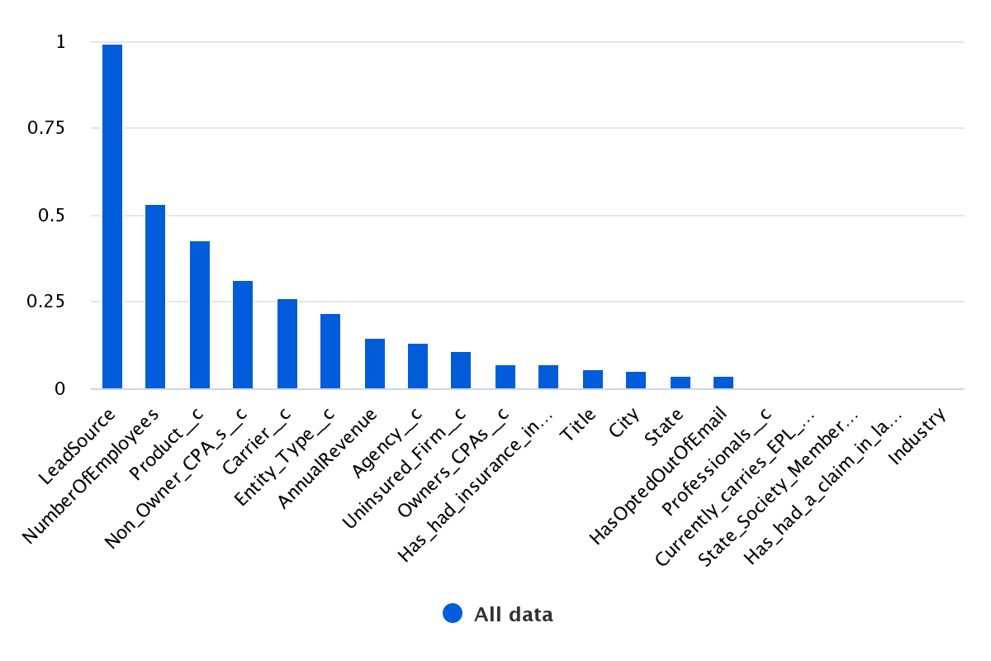
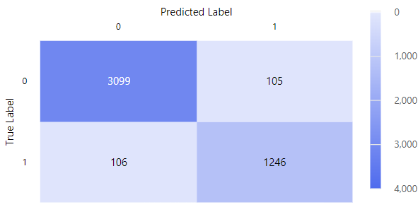
Leads Model Training results
Key Predictive Features for Leads to Opportunities Conversion:
Lead Source: The source from which leads originate plays a pivotal role in predicting the likelihood of conversion to opportunities.
Number of Employees: The size of the company, as represented by the number of employees, is identified as another critical feature influencing the conversion process.
Model Overview:
Type: Voting Ensemble
Strengths: Demonstrates robust performance on a biased dataset with missing values.
Training Data: Utilized the Leads table consisting of 13k Converted and 32k Not Converted instances.
Dataset Split: Employed a split of 90% for training and 10% for testing.
Performance Metrics:
Achieved a remarkable Weighted Area Under the Curve (AUC).
Attained an impressive 99% accuracy.

Slide 37
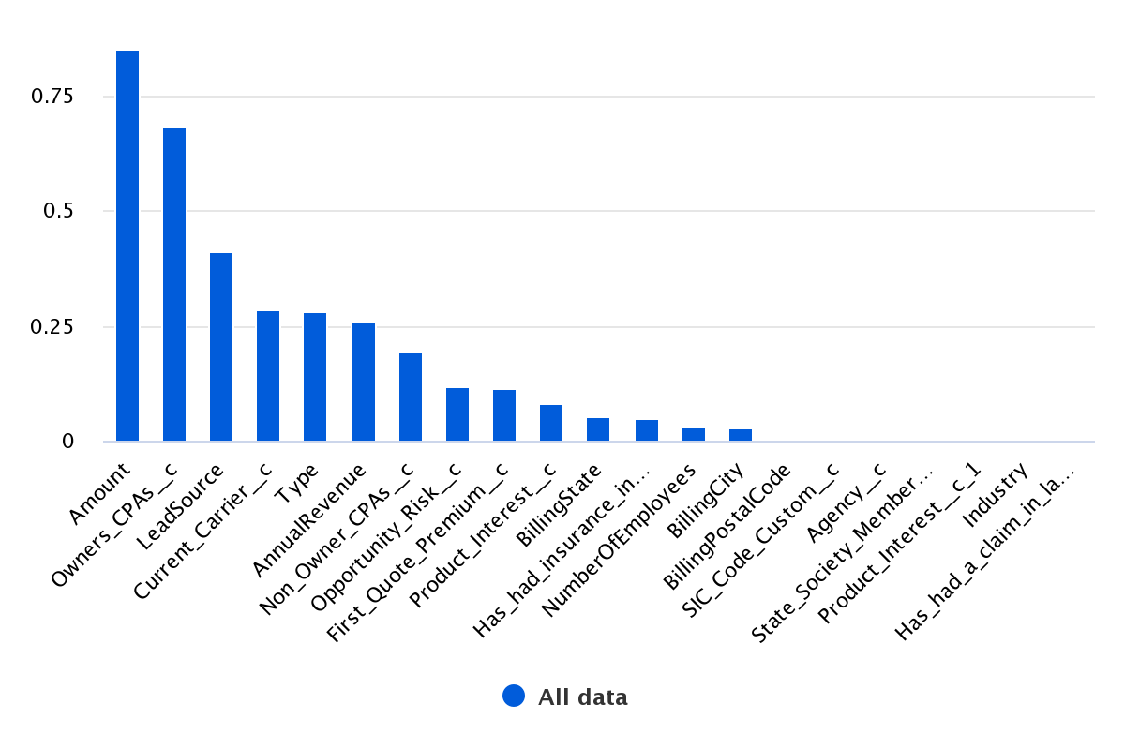
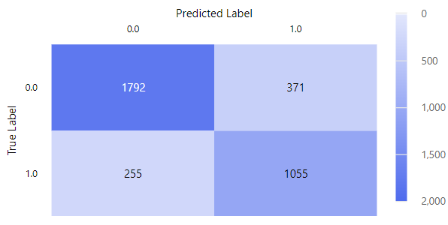
Opportunities Model Training results
Key Predictive Features for Leads to Opportunities Conversion:
Amount: The monetary value associated with opportunities emerges as a crucial predictor for conversion.
Owner’s CPA: The involvement and influence of the Owner's CPA significantly impact the conversion likelihood.
Lead Source: The source from which leads originate plays a pivotal role in predicting the conversion of leads to opportunities.
Type: The classification or type of opportunities is identified as another vital feature influencing the conversion process.
Model Overview:
Type: Voting Ensemble
Strengths: Demonstrates effectiveness on a biased dataset with missing values.
Training Data: Utilized the Leads table with 13k Converted and 21k Not Converted instances.
Dataset Split: Employed a split of 90% for training and 10% for testing.
Performance Metric:
Achieved a solid Weighted Area Under the Curve (AUC) of 90%.

Slide 38
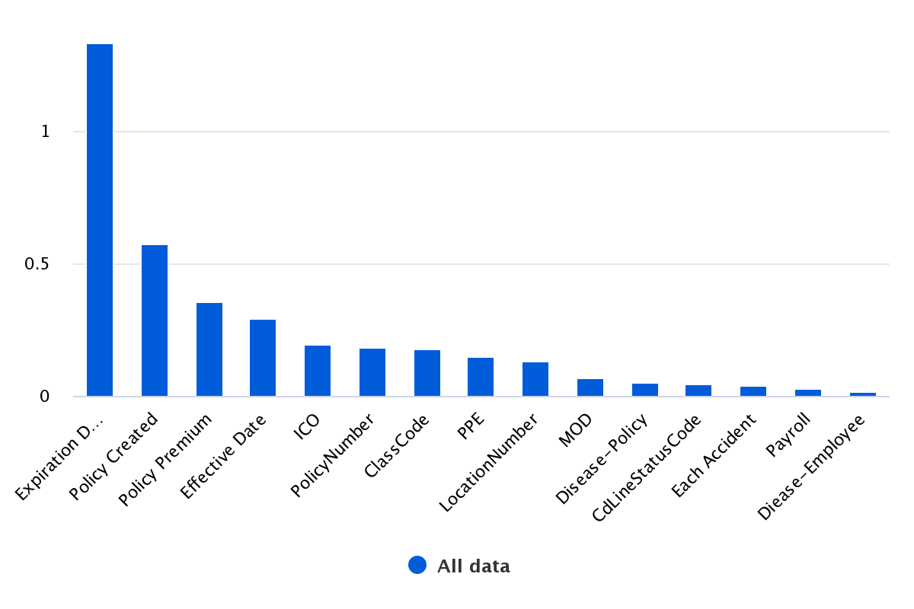
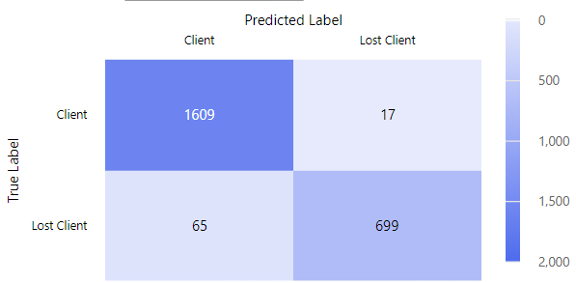
Lamb Worker Compensation Dataset
Key Predictive Features for Wins and Losses:
Expiration Date: The date on which policies expire emerges as a pivotal feature for predicting outcomes, indicating its impact on wins and losses.
Policy Creation Date: The date when policies are created is identified as a critical factor influencing the likelihood of wins or losses.
Policy Premium: The monetary value associated with policy premiums is a significant predictor for outcomes, contributing to the prediction of wins and losses.
Model Overview:
Type: Random Forest
Strengths: Demonstrates effectiveness on a biased dataset.
Training Data: Utilized the Lamb table with 16k Clients and 8k Lost Clients instances.
Dataset Split: Employed a split of 90% for training and 10% for testing.
Accuracy: Achieved a robust accuracy of 96% on the test set, with a breakdown of 91% for Lost clients and 98.9% for Won clients.

Slide 39
Camico : Opportunity Insights

Slide 40
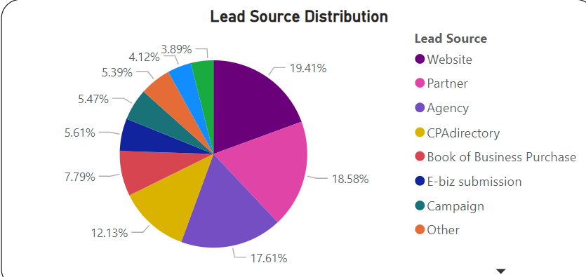
Insights : Lead Source Distribution
Partner and website Collaborations: Substantial leads are generated from partner and website collaborations.

Slide 41
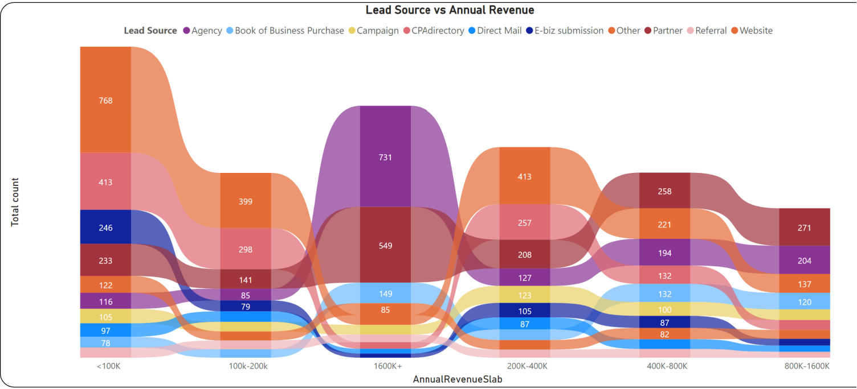
Insights : Lead Source v/s Annual Revenue
- Strategic Annual Revenue Opportunities:
Utilizing the website’s true potential can generate a lot of opportunities for lower revenue and higher revenue.
On the higher revenue side we can improve our focus on agency and partner for converting opportunities.

Slide 42
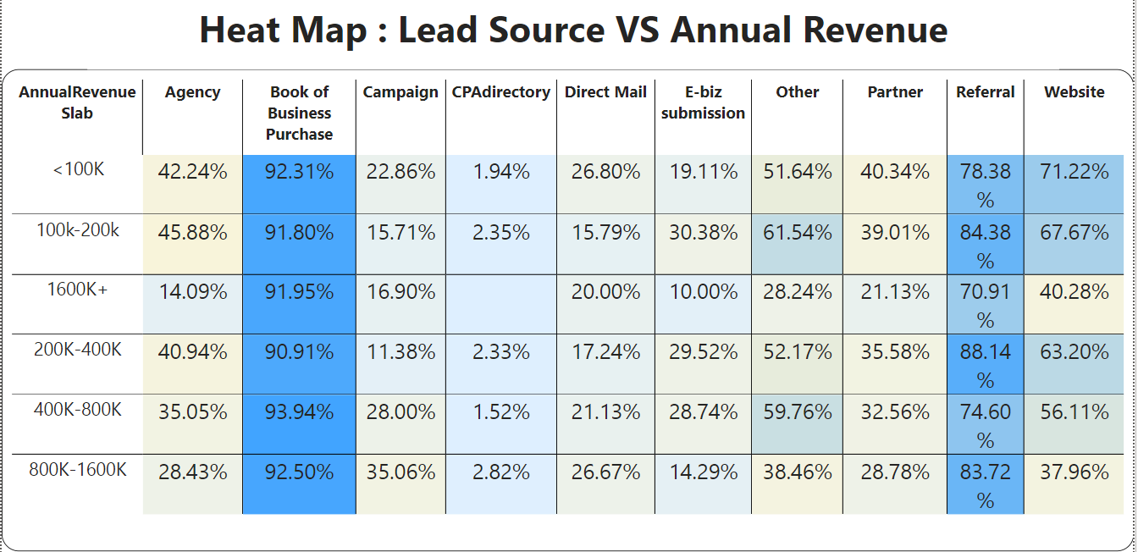
Insights : HeatMap for Lead Source(X) vs Annual Revenue(Y)
Strategic Revenue Enhancement:
Main Focus: Book of business purchase, Referral, Website
Most of the opportunities are coming from Book of business purchase and Referral while focusing on the website will be an added advantage.
Strategically maintaining a good pool of Referral, Book of business will take lead generation to new height.

Slide 43
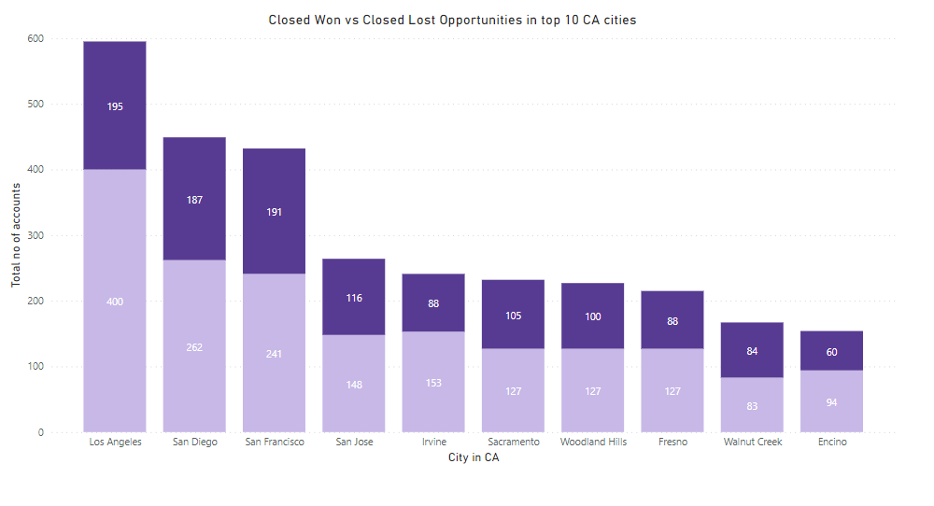
Conversion Comparison in CA Cities
Conclusion:
No significant variation or trend was observed in the Conversion Ratio across different cities.
Across almost all cities, approximately 35% of leads are successfully closed as 'won,' while the others are marked as 'lost'.

Slide 44
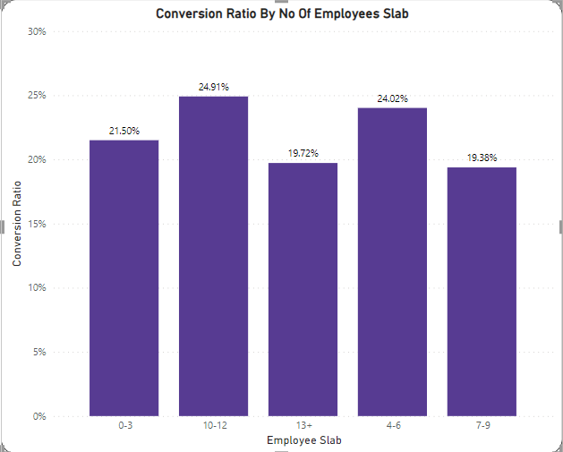
Conversion Ratio v/s Number of Employees
Conclusion:
The changing scenario of number of employees leads to a fluctuating conversion ratio.

Slide 45
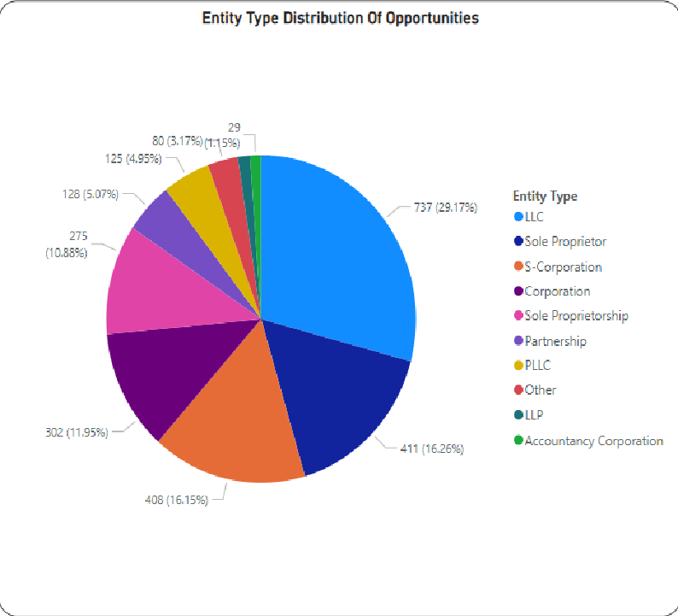
Insights : Entity Type Distribution
Major business Contributors: LLC, Sole Proprietor, S-Corporation
LLC, Sole Proprietor and S-Corporation has given a business boost and lead us to a lot of opportunities
A good Strategical planning ensures effective positioning and engagement across LLCs, S-Corporations, Sole Proprietorships, and Corporations, maximizing opportunities in each business entity category.

Slide 46
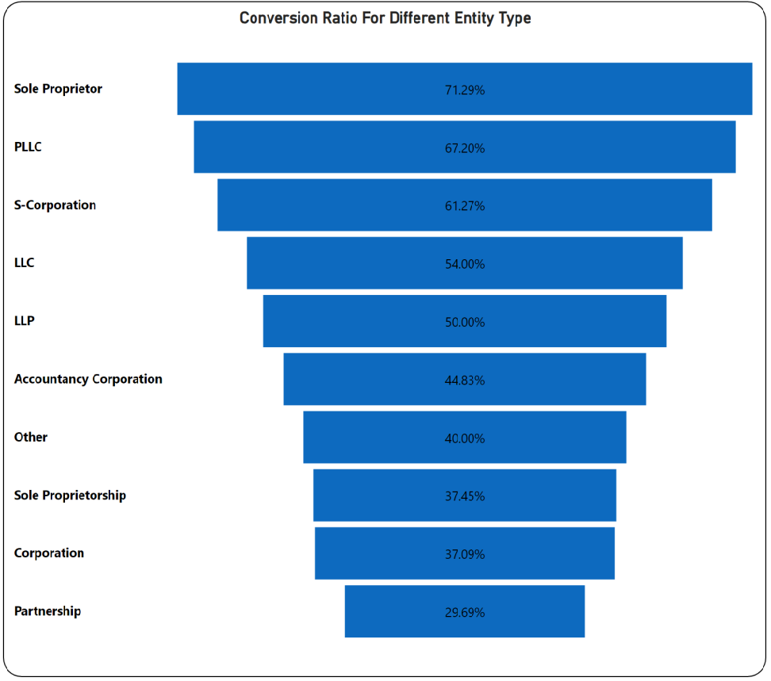
Insights : Different entity types
Corporations' Impact Analysis:
Corporations create lots of chances, but they don't always turn them into success. On the other hand, smaller setups like Sole Proprietors (PLLC), LLCs, and LLPs are doing great. They not only grab opportunities but also turn them into wins. So, larger entity types convert a lot more by a better planing and focusing on Entities like Sole Proprietors , PLLC, S-Corporation we can convert a lot more opportunities.

Slide 47
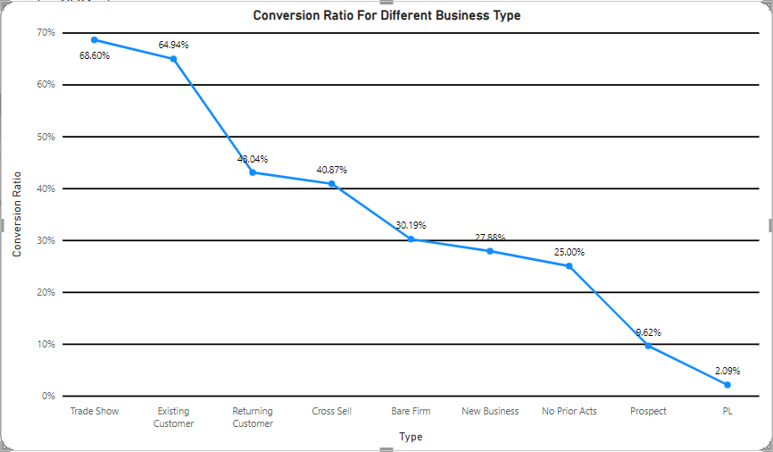
Insights : Different business types
Conclusion:
Bare Firms and New Businesses significantly contribute to more opportunity conversion but face a lower conversion rate. Strategically tailoring conversion strategies for these segments is recommended to enhance overall sales effectiveness and optimize performance.

Slide 48
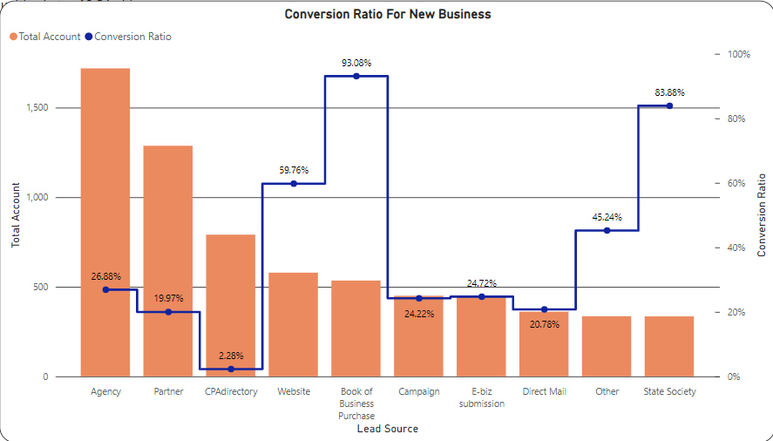
Insights : New Businesses
Strategic Focus for Lead Generation and Conversion:
Prioritize high conversion ratio sources like Books of Business Purchases, Websites, and State Society. Optimize strategies for higher account number sources, including Agency, Partner, and CPAdirectory. Emphasize improving conversion rates by enhancing lead quality and refining sales approaches. Balancing this prioritization ensures a nuanced approach, optimizing overall effectiveness.

Slide 49
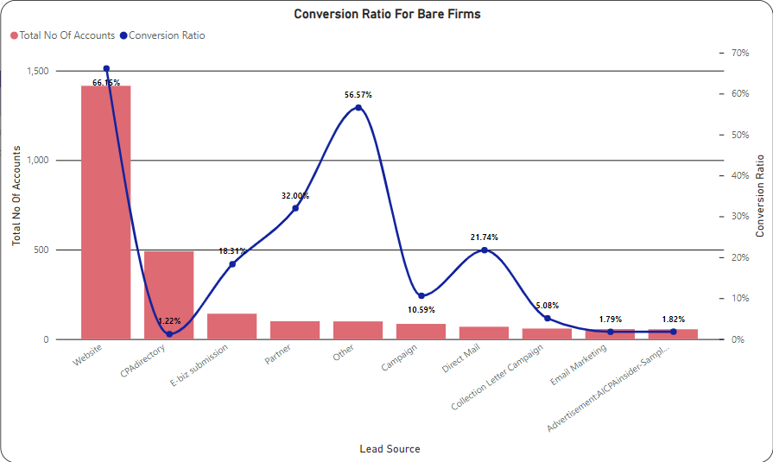
Insights : Bare Firms
Evaluate performance metrics: CPAdirectory, though with a lower conversion ratio, is the second-highest contributor; the Website leads in both contribution and conversion ratio. Strategically, prioritize enhancing CPAdirectory's conversion rate while consistently maintaining and improving the Website's performance. A balanced approach ensures optimal overall sales effectiveness. Harmonizing efforts between optimization and performance is vital for success.

Slide 50
Insights : Top 10 popular states
Focus on high-lead volume states: California, Texas, and New York.
Direct sales efforts and formulate targeted strategies for these regions.
High potential for lead conversions, fostering substantial business growth.
Strategically align resources to enhance market presence in key geographical areas.

Slide 51
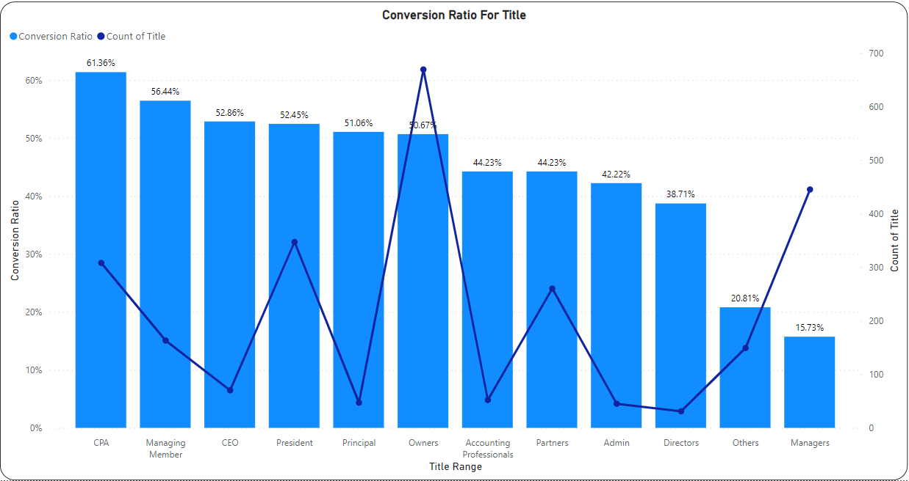
Insights : Contact title v/s time
Lead Title Dynamics:
- High contact volume for titles like Owner, Mr., President, Partner, and CPA.
- CEO, Managing Manager, and Sole Proprietor show higher conversion percentages, signaling successful closures.
Time-Conversion Relationship:
- Average lead conversion time: 174 days.
- Inverse relationship between time taken and conversion chances, emphasizing the need to optimize processes for quicker conversions and enhance overall sales outcomes.

Slide 52
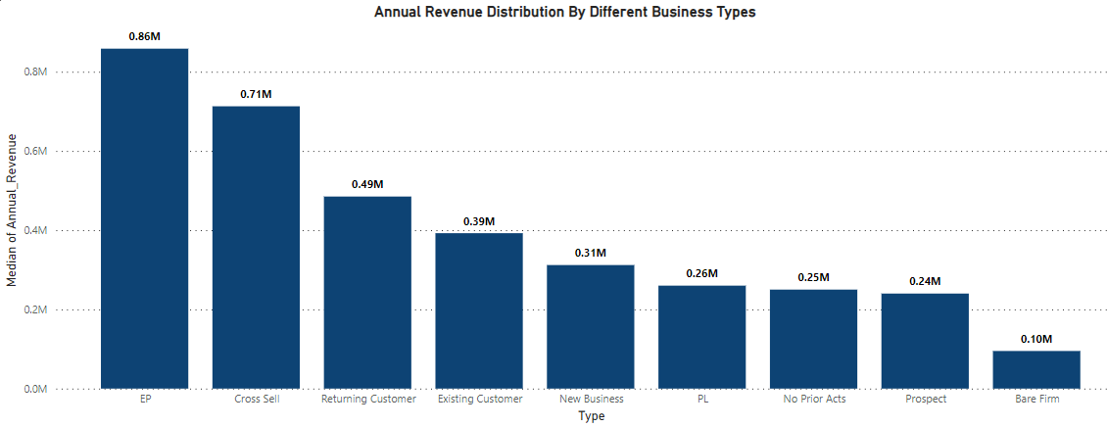
The trend shows EP, cross sell and returning customer has a market dominance and are capable of getting higher revenue.

Slide 53
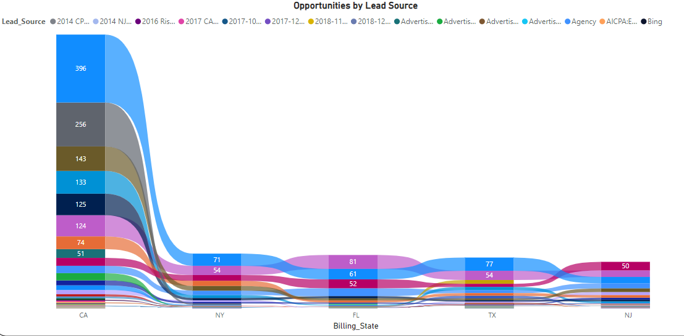
Focus area: Agency and State Society
The agency and state society are leading assets in getting a lot of opportunities as compared to other lead sources.
Proper utilization of these lead source in an efficient manner will enable more business opportunities.

Slide 54


